Slide 1
Profile App
Just some notes

Slide 2
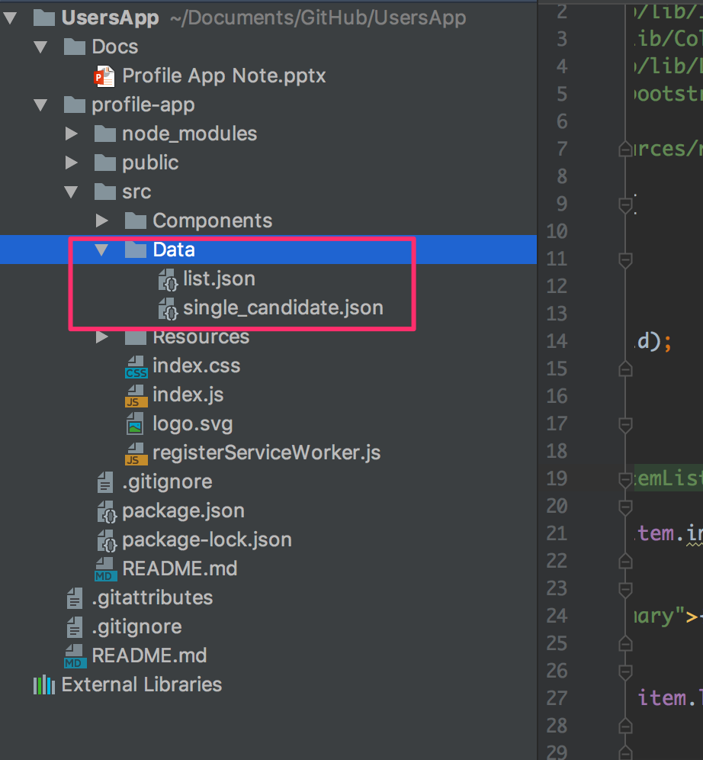
Data
Data is stored here, src/Data/
This folder was put into git ignored list for Github,
so such folder in Github

Slide 3
Theme
I used React-bootstrap, https://react-bootstrap.github.io/

Slide 4
Layout design
I applied the concept of master page with list view and detail view, inspired by Mac Mail App
List View
Item
Detail View
Item

Slide 5
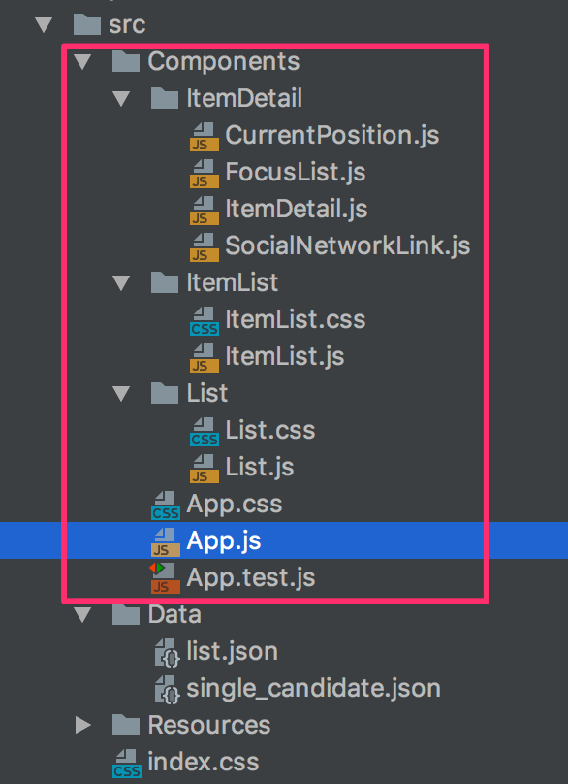
Components
There are 3 main components : List, ItemList and ItemDetail
Since the ItemDetail is big, I broke it down into 4 more components i.e FocusList, SocialNetwork

Slide 6
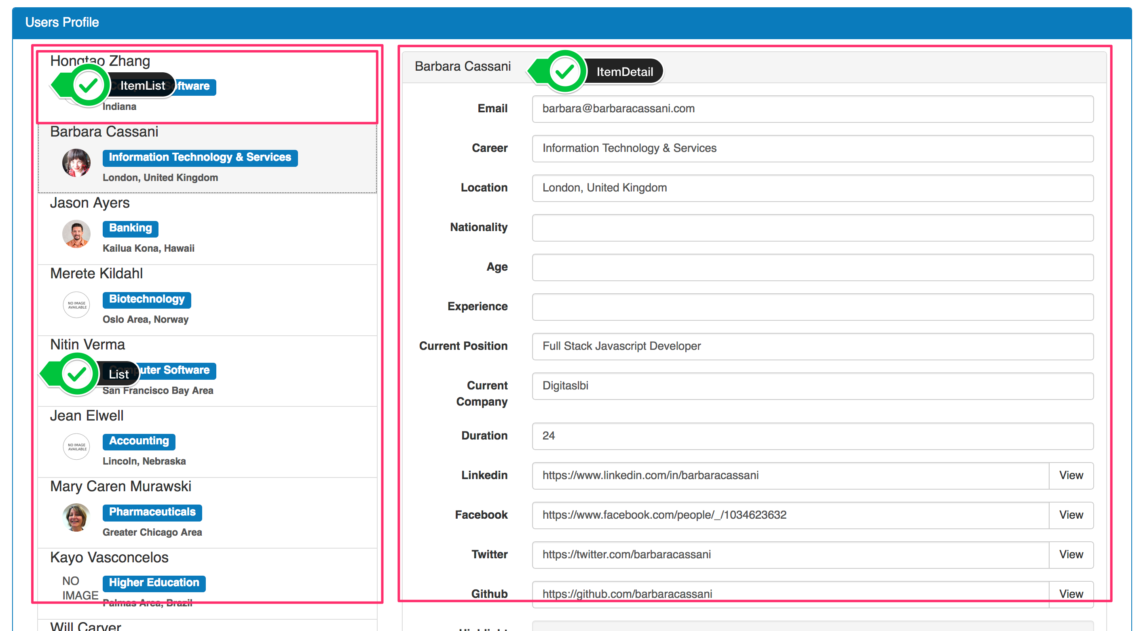
Components

Slide 7
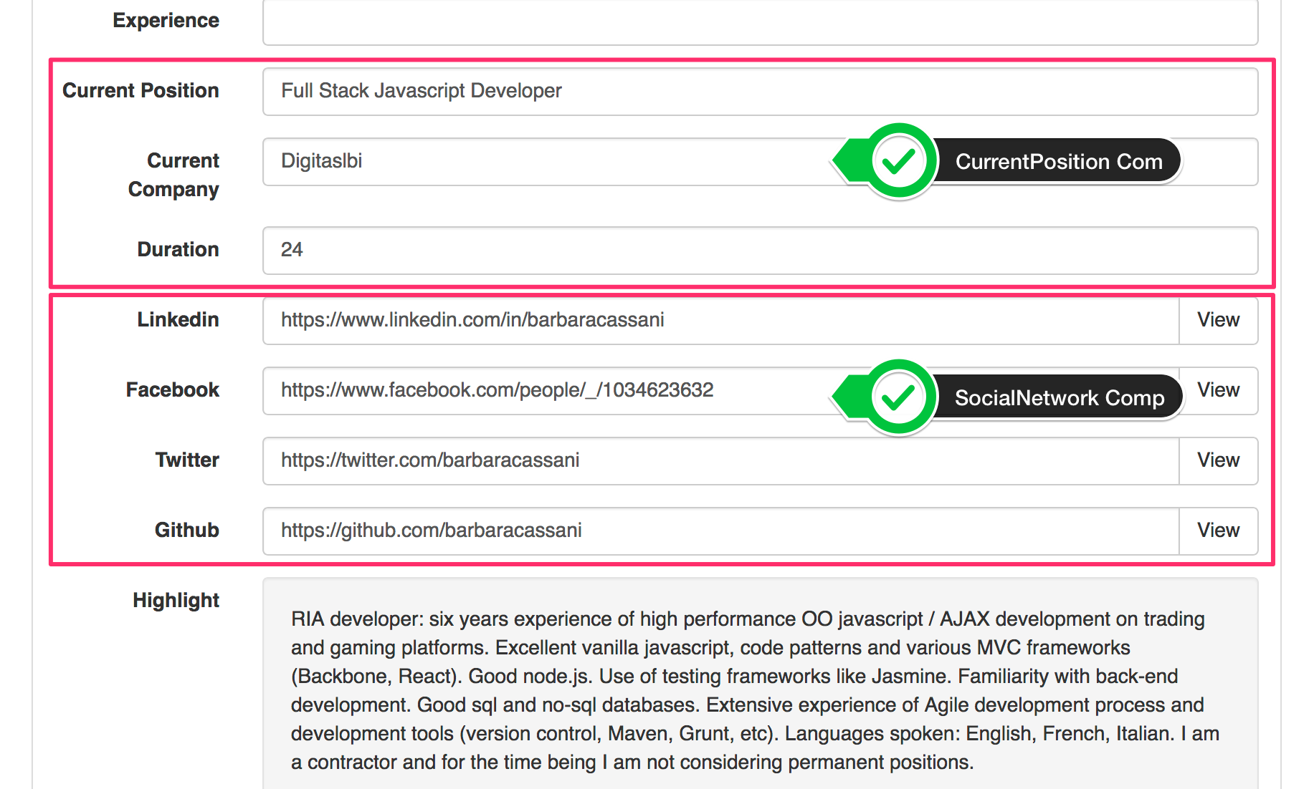
More Components

Slide 8
Github link
https://github.com/SamphorsKhlok/UsersApp
Docs folder is to keep all related document for the project. Usually I do it in Power Point coz sometimes I need to Demo or explain to management team. It is used for job rotation and knowledge transfer as well.

Slide 9
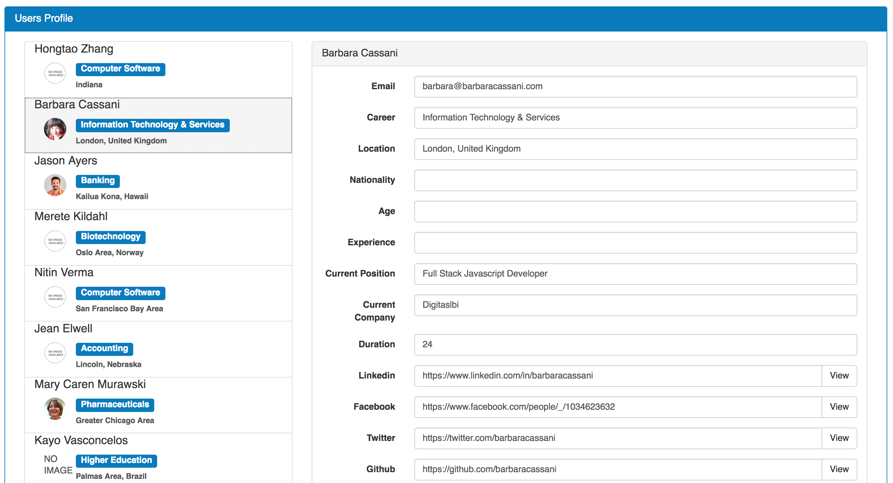
Final look

